Slide 1
AVL Tree Operations

Slide 2
Points to remember
Rotations are done only on 3 nodes whatever maybe the size of the tree.
Balance factor = Height of left subtree – Height of right subtree.
Balance factor. = hl-hr ={-1,0,1}
Balance factor has to be calculated for every node.
Leaf nodes has balance factor 0.
If any node has BF other than -1,0 or 1, that node is said to be imbalanced;
That node needs to be balanced by performing rotations.

Slide 3
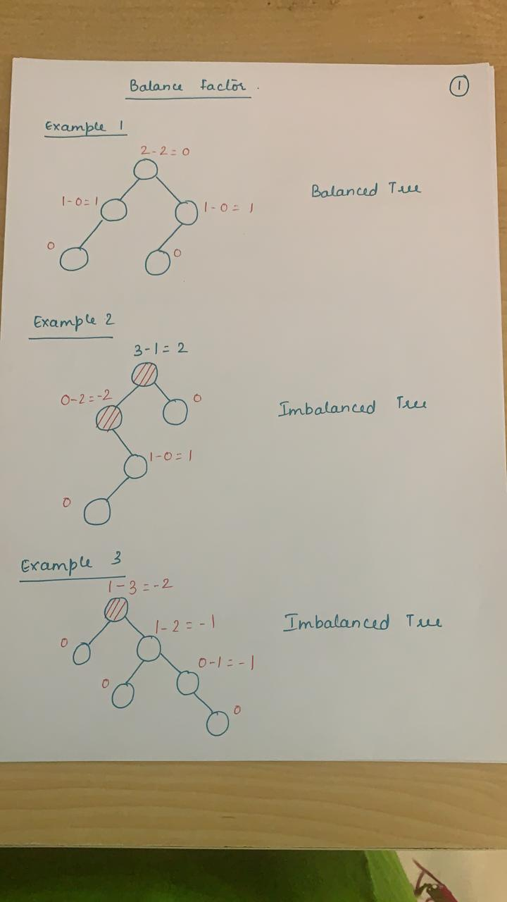

Slide 4
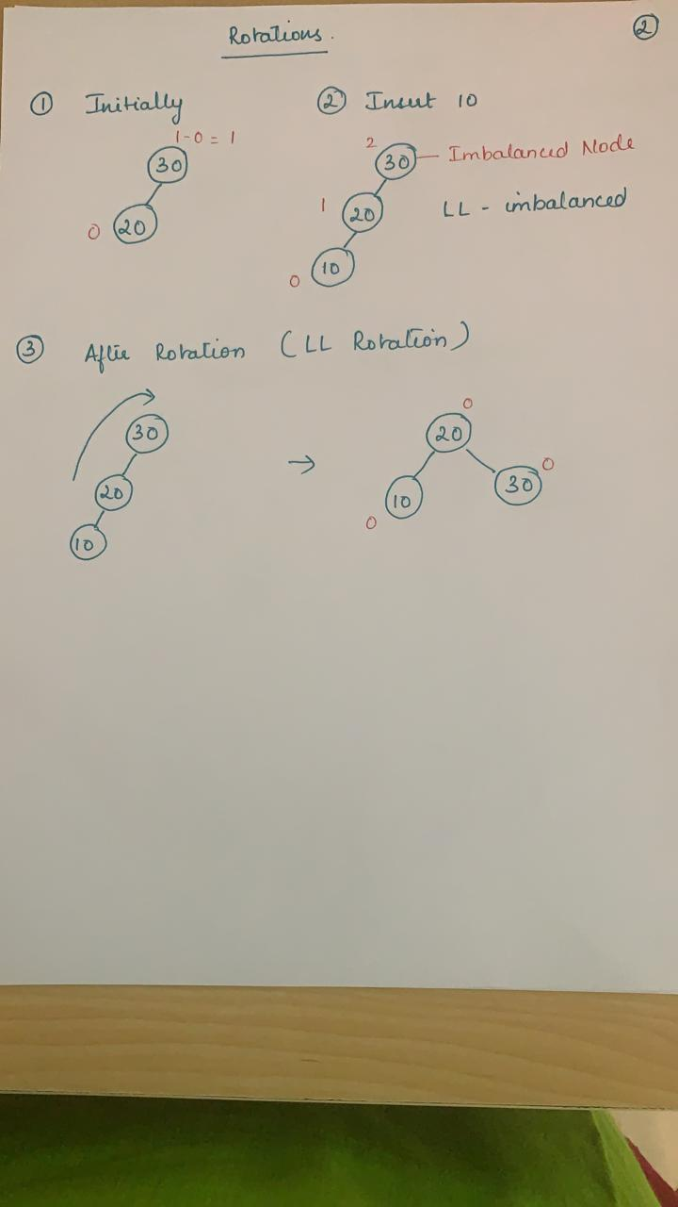

Slide 5
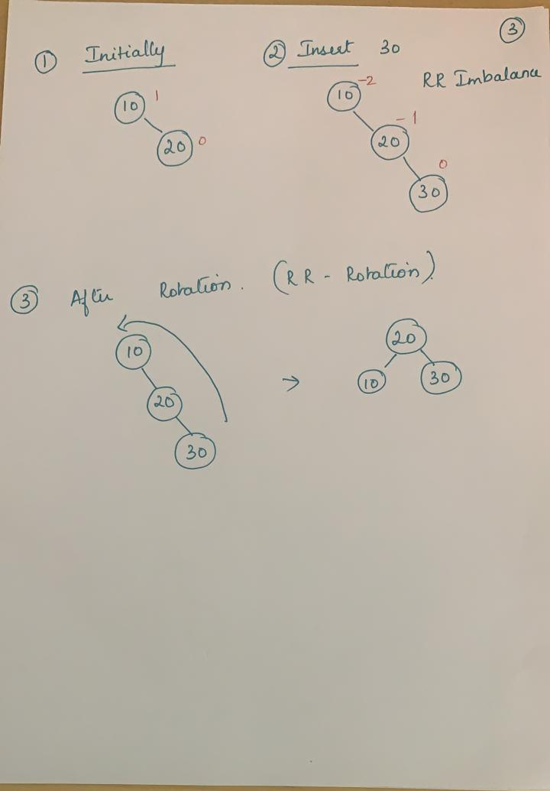

Slide 6
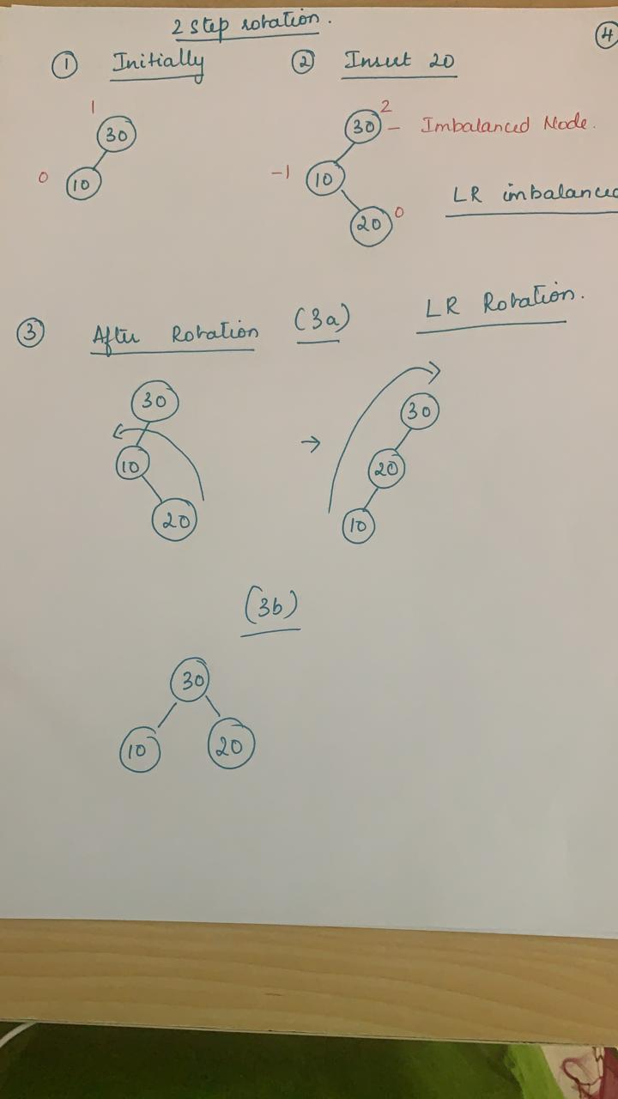

Slide 7
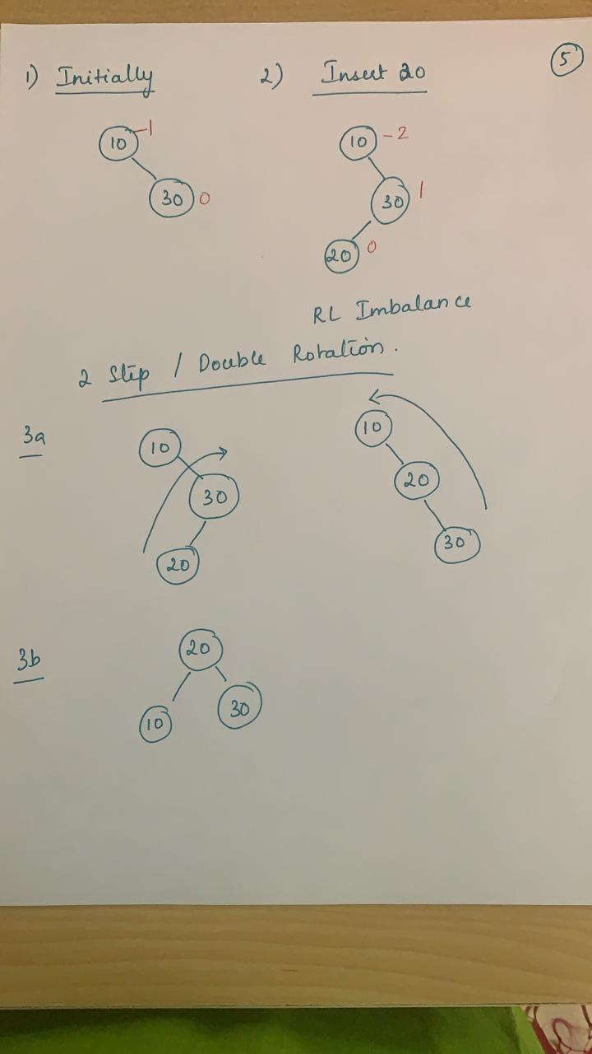

Slide 8
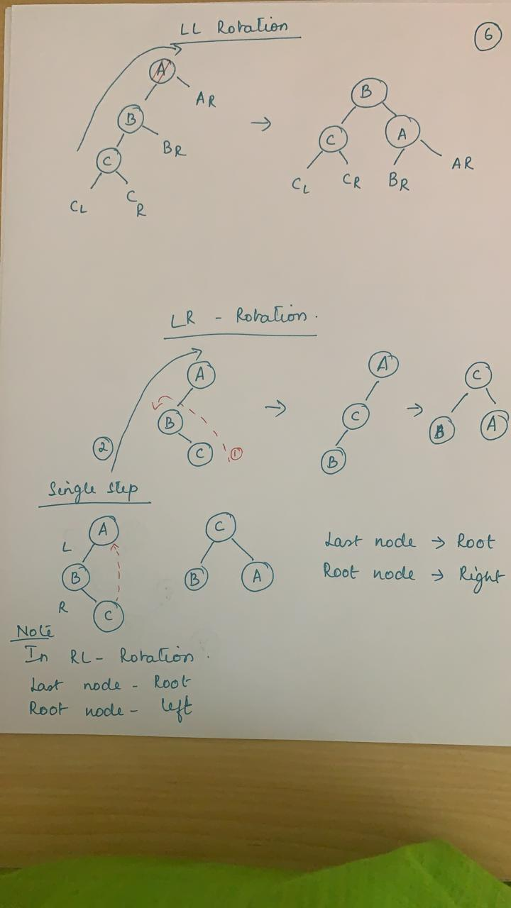

Slide 9
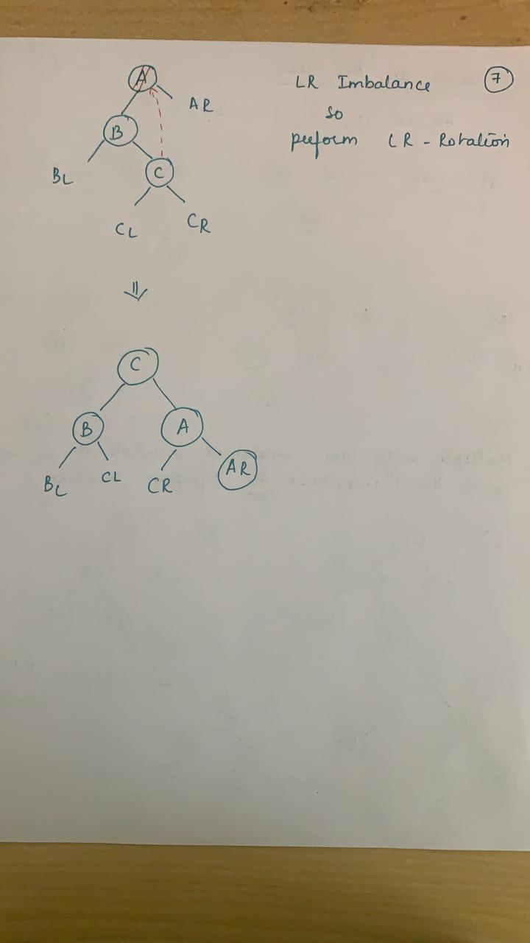

Slide 10
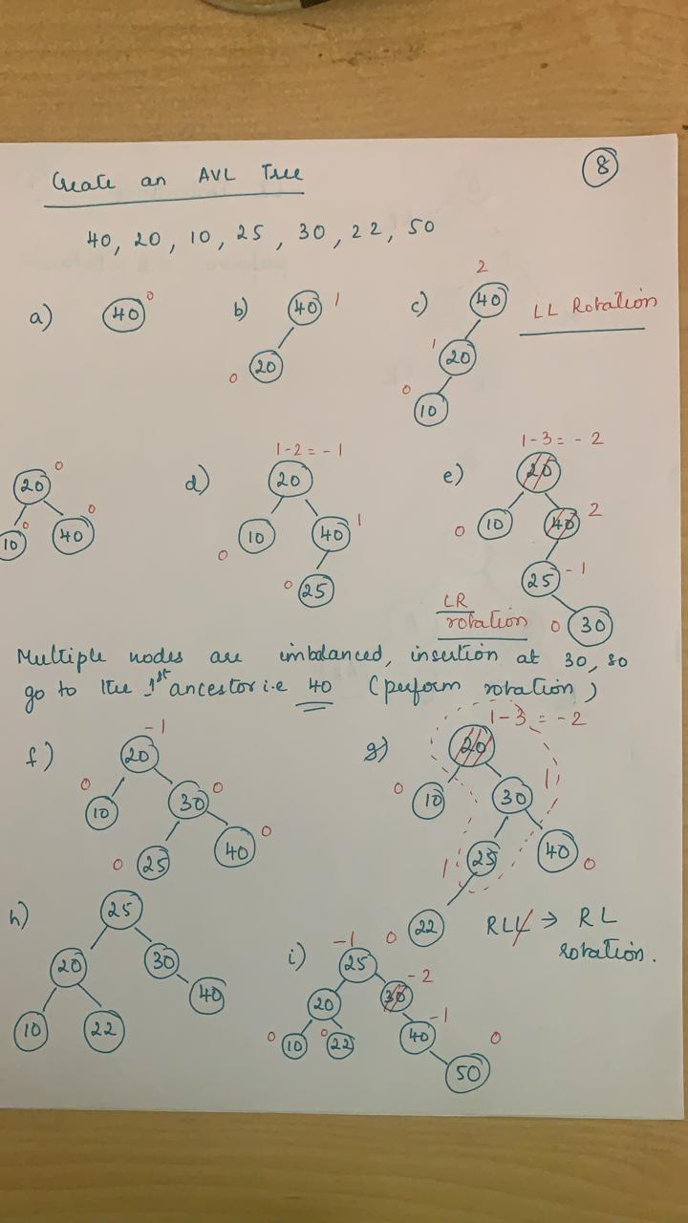

Slide 11
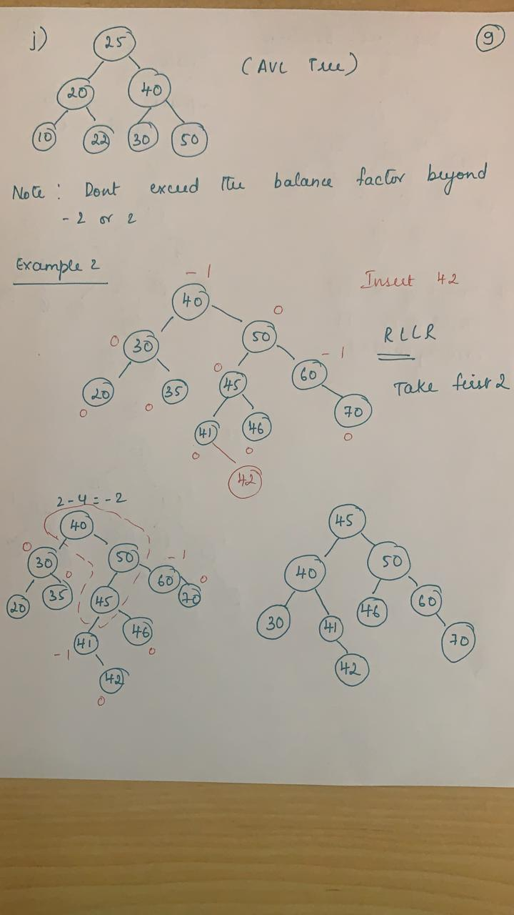

Slide 12
